Slide 1
AD-HTC Fuel-Enhanced Gas Cycle Analysis

Slide 2
Group Members
Omojola Olusegun David
Oyewole Emmanuel abiodun
Adebayo Temitope John
Aloku Josiah Adeboye
Yusuf Waliu Ayomide

Slide 3
Background
• Biomass energy
• AD produces biogas
• HTC enhances fuel properties

Slide 4
System Configuration
• Gas turbine
• Steam turbine
• Heat recovery

Slide 5
Brayton Cycle
• Compression
• Combustion
• Expansion
• Efficiency equation

Slide 6
Rankine Cycle
• Pump
• Boiler
• Turbine
• Condenser

Slide 7
Modeling Assumptions
- Steady-state operation
- Ideal gas behavior for air
- Fixed air–fuel ratio
- Negligible pressure losses
- Constant isentropic efficiencies

Slide 8
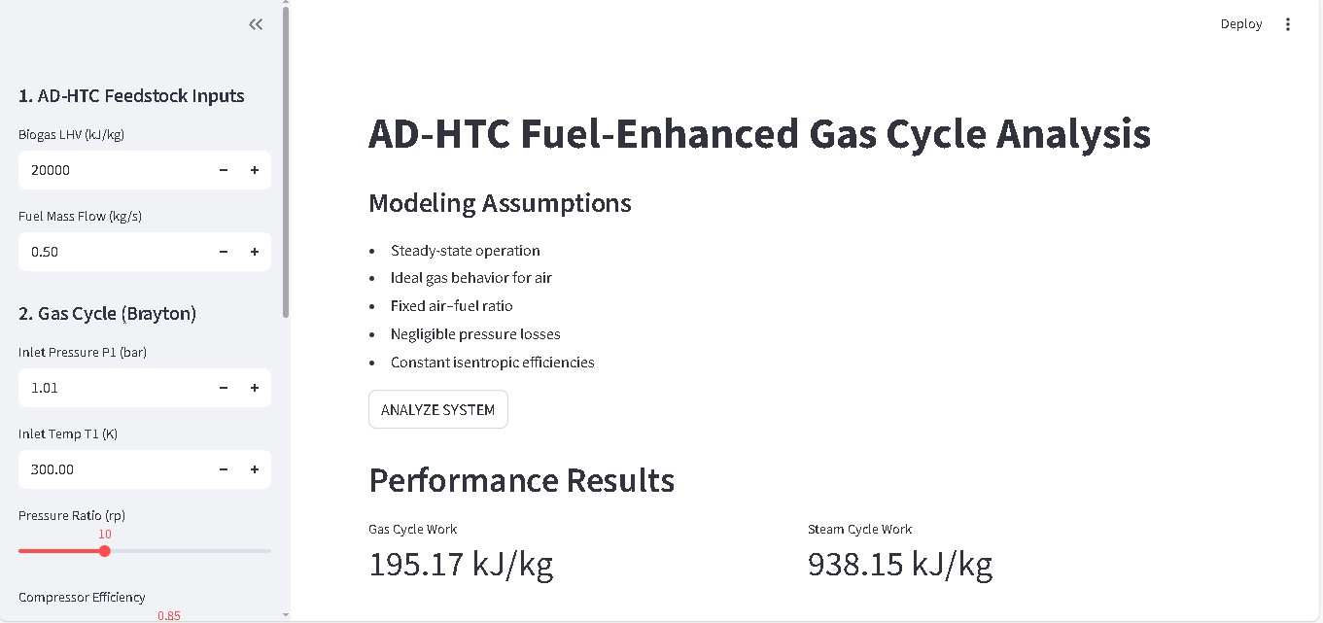
Simulation Interface Screenshot

Slide 9
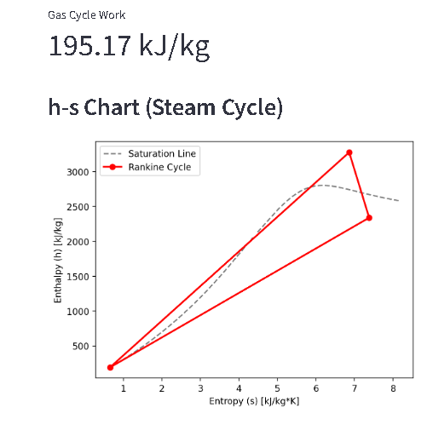
h–s Diagram

Slide 10
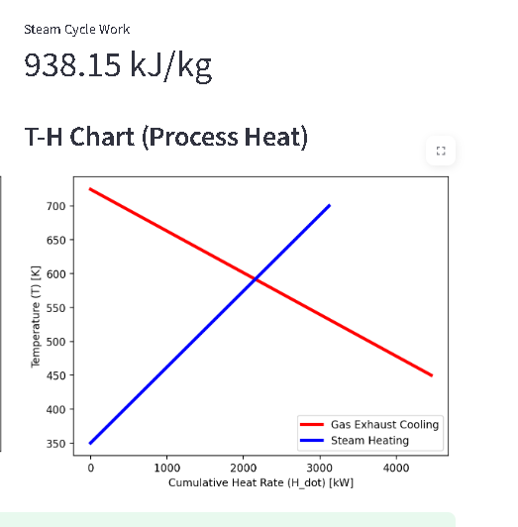
T–H Diagram

Slide 11
Conclusions
The developed simulation successfully models an AD-HTC fuel-enhanced combined cycle system. The integration of Brayton and Rankine cycles improves thermodynamic efficiency and demonstrates the potential of biomass-based fuel enhancement in sustainable power generation.

